Slide 1
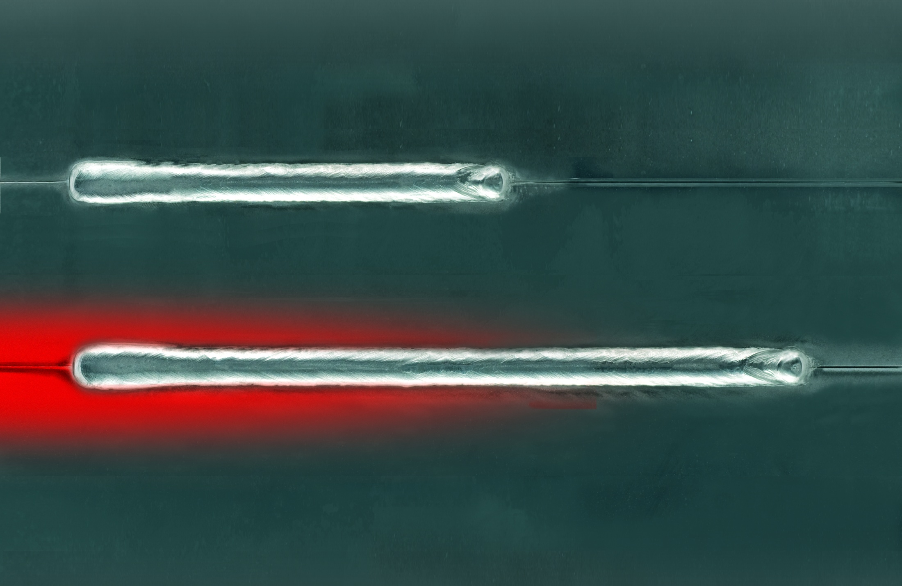
SpeedArc
SpeedArc for more Speed!
Presented by Lorch
2012 | Lorch Schweißtechnik GmbH | www.lorch.eu

Slide 2
Contents:
Our innovation
Advantages and Use
Applications
Unit and Operation

Slide 3
Our Innovation.

Slide 4
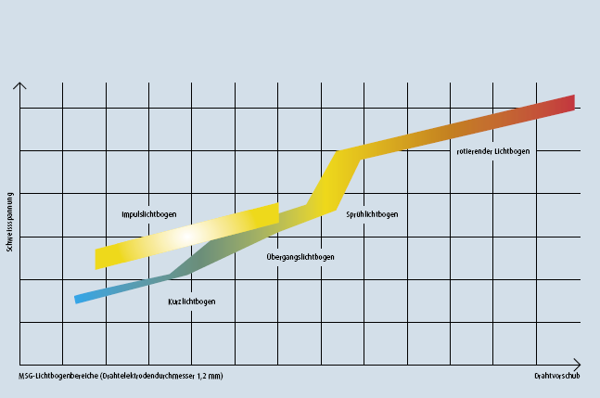
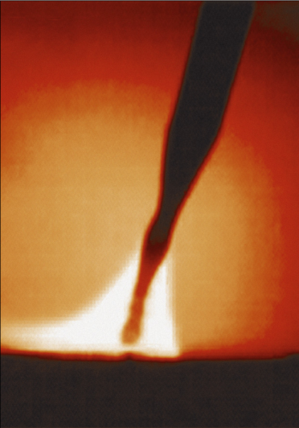
Material transition at MIG/MAG welding
SpeedArc-range
ROTATING ARC
VOLTAGE
PULSE ARC
SPRAY ARC
SpeedArc
SHORT ARC
MIXED ARC
MSG ARC RANGES ARE USING 1.2MM WIRE
WIRE SPEED

Slide 5
SpeedArc Penetration
Spray
Speed-Arc
312A
31,5V
40cm/min
10m/min
5,5mm
1,6mm
7,1mm
power
voltage
travel speed
wire speed
a-Mass
e-Mass
total a-value
308A
30,4V
53cm/min
12m/min
5,5mm
2,8mm
8,3mm

Slide 6
Spray arc
Little Spatter whilst welding
Non-short-circuit droplet transmission
High energy density
Application at thick materials only
Deep penetration and wider seam geometry
High energy input per length and thus risk of distortion
Large heat affected zone

Slide 7
SpeedArc
Is related to the spray arc range (high performance hybrid spray arc)
Significantly higher arc focusing
Higher energy density
Higher arc pressure in to the weldpool
Application from 3mm possible
Very little or no spatter

Slide 8
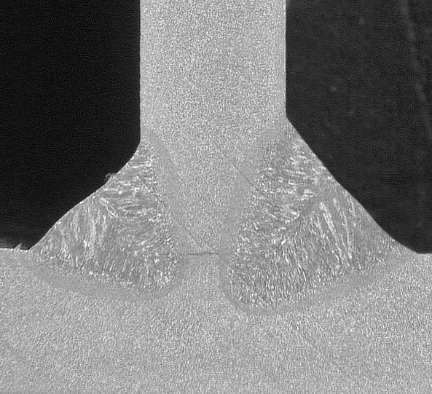
SpeedArc penetration comparison
MIG/MAG-Standard
MIG/MAG-SpeedArc
smooth seam transitions
reduced heat affected zone
deeper penetration
Risk of undercut
normal penetration
larger heat affected zone

Slide 9
Advantages/Use

Slide 10
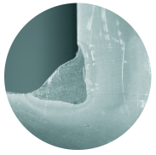
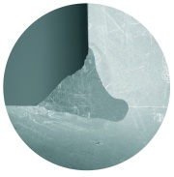
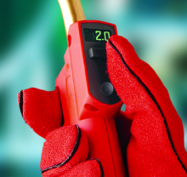
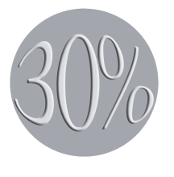
SpeedArc advantages/use
Deeper penetration due to high plasma pressure in the arc
Easy to use in manual welding applications due to incredibly stable arc
Less undercut
Increased profitability due to higher welding speed
Better seam quality in regard to the heat affected zone and less distortion due to less heat input
Minimal or no spatter formation

Slide 11
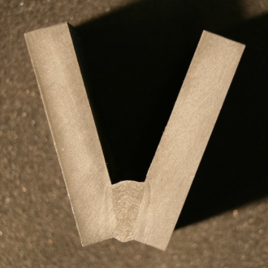
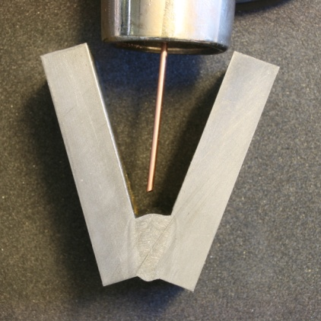
SpeedArc effects/use
Root area is visibly better
Less seam preparation
Smaller weld prep angle required
less material removal
less filler material
clear root capture
according to requirements, thicker materials may be welded in a single pass
Smaller gaps, less layers, less gas, less filler materials
Longer stick-out possible

Slide 12
SpeedArc effects/use
Can weld with a longer stick out
Obvious higher arc pressure
Easier placement of the arc into the root
Good toe/pool wettability
Torch angle less critical
More user friendly than standard Spray

Slide 13
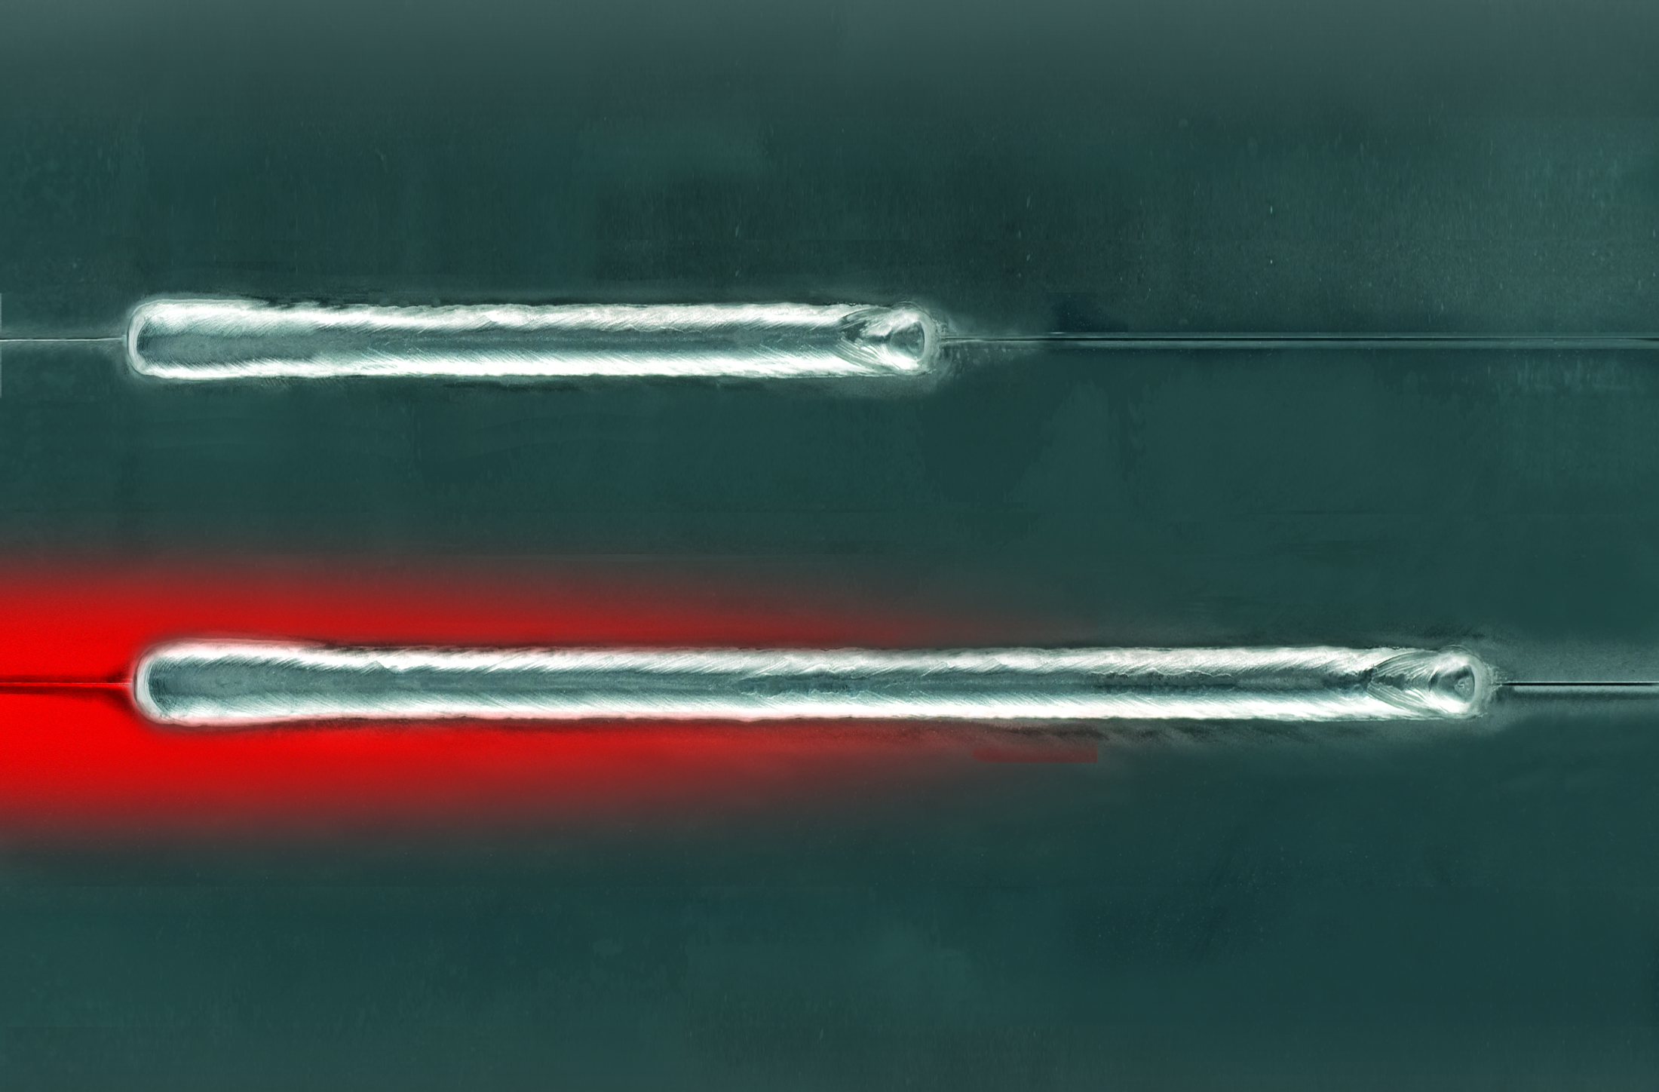
SpeedPulse
Simply faster. Simply pulse.
Referent:
2009 | Lorch Schweißtechnik GmbH | www.lorch.eu

Slide 14
SpeedPulse
During the process the pulse remains
Unlike conventional pulse process 1 material continues to 2 flow between the Pulse 3
No short circuits
Has advantages on materials of 1 mm thickness and greater
For steel/stainless steel/aluminium

Slide 15
SpeedPulse advantages

Slide 16
SpeedPulse advantages

Slide 17
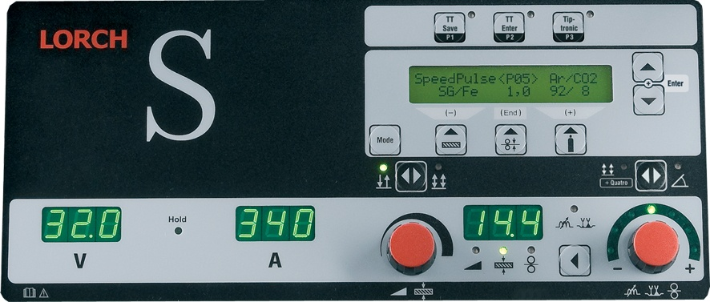
3-Steps to Weld Operating Concept
1. Operation mode 2- , 4-Stroke, Quatromatic
2. Wire/gas/material combination
(easy text dialogue)
3. Welding Curent

Slide 18
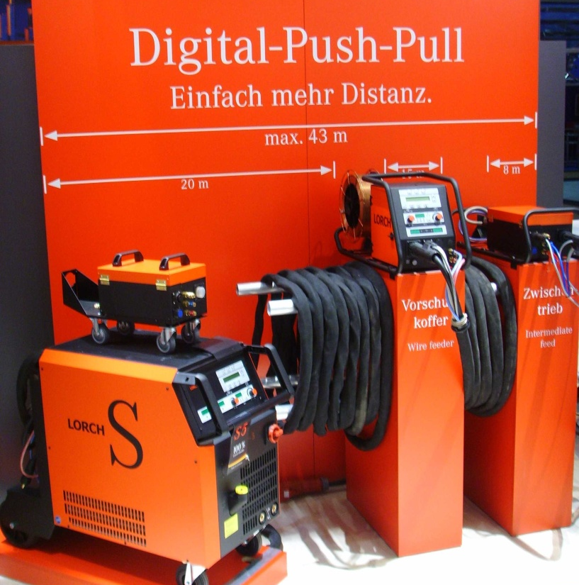
SpeedArc/SpeedPulse advantages
Connection with long interpass hosepackages
Intermediate drive solutions
Digital PushPull-solutions

Slide 19
Applications

Slide 20
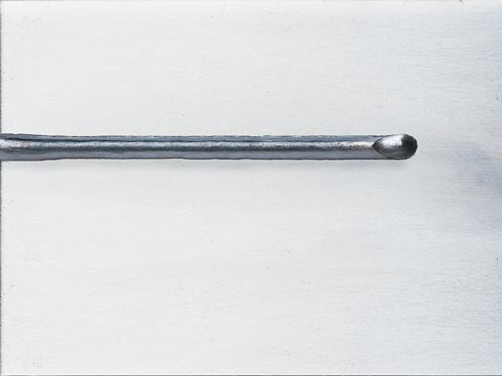
SpeedArc/SpeedPulse applications
Metal fabrication, plant and machinery construction
Vehicles, track-bound (rail) vehicles and shipbuilding
Container, device and equipment construction, offshore and others
Manual and mechanized /automated applications
mild steel
fine grained steel
stainless steel
aluminium

Slide 21
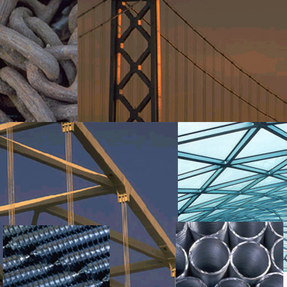
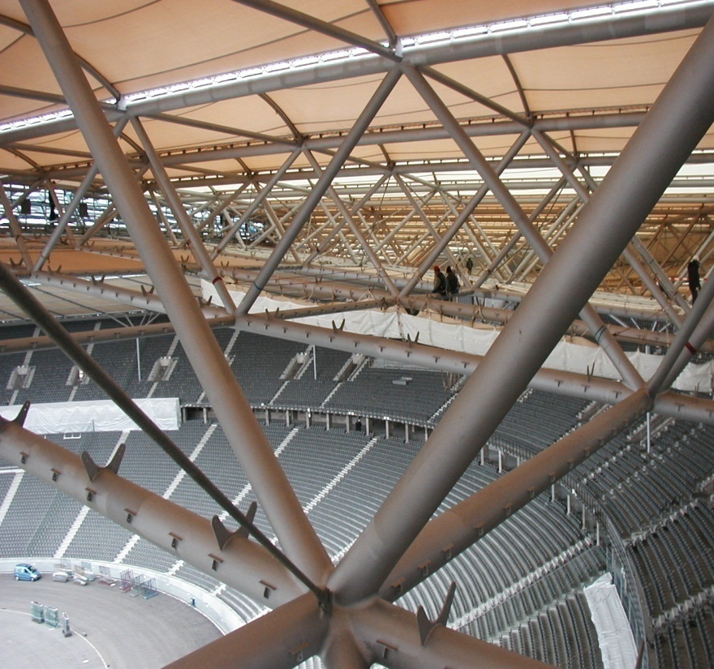
SpeedArc/SpeedPulse applications
Metal construction, plant and machinery construction

Slide 22
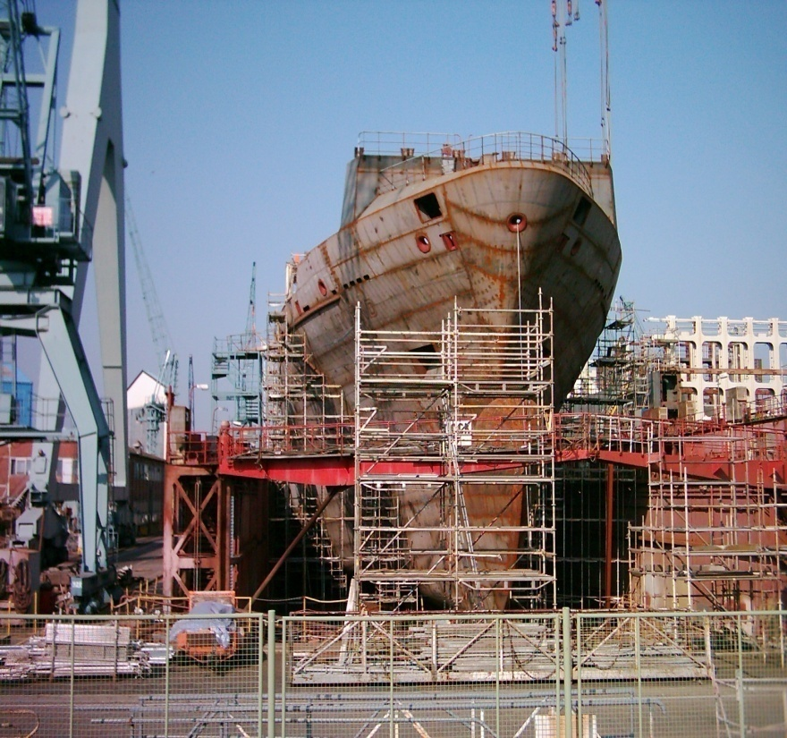
SpeedArc/SpeedPulse applications
Vehicles, track-bound (track) vehicles and shipbuilding

Slide 23
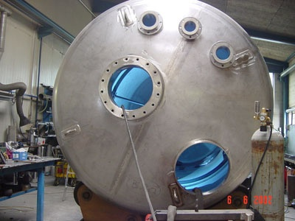
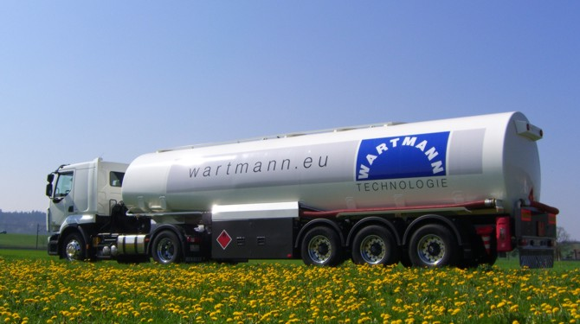
SpeedArc/SpeedPulse applications
Container, device and equipment construction, offshore and others

Slide 24
Thank you

